Slide 1

CS 352
Transport: Wrap-Up
Lecture 18
http://www.cs.rutgers.edu/~sn624/352-F22
Srinivas Narayana

Slide 2


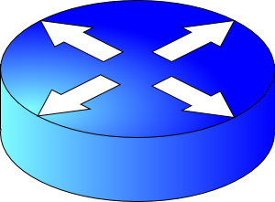
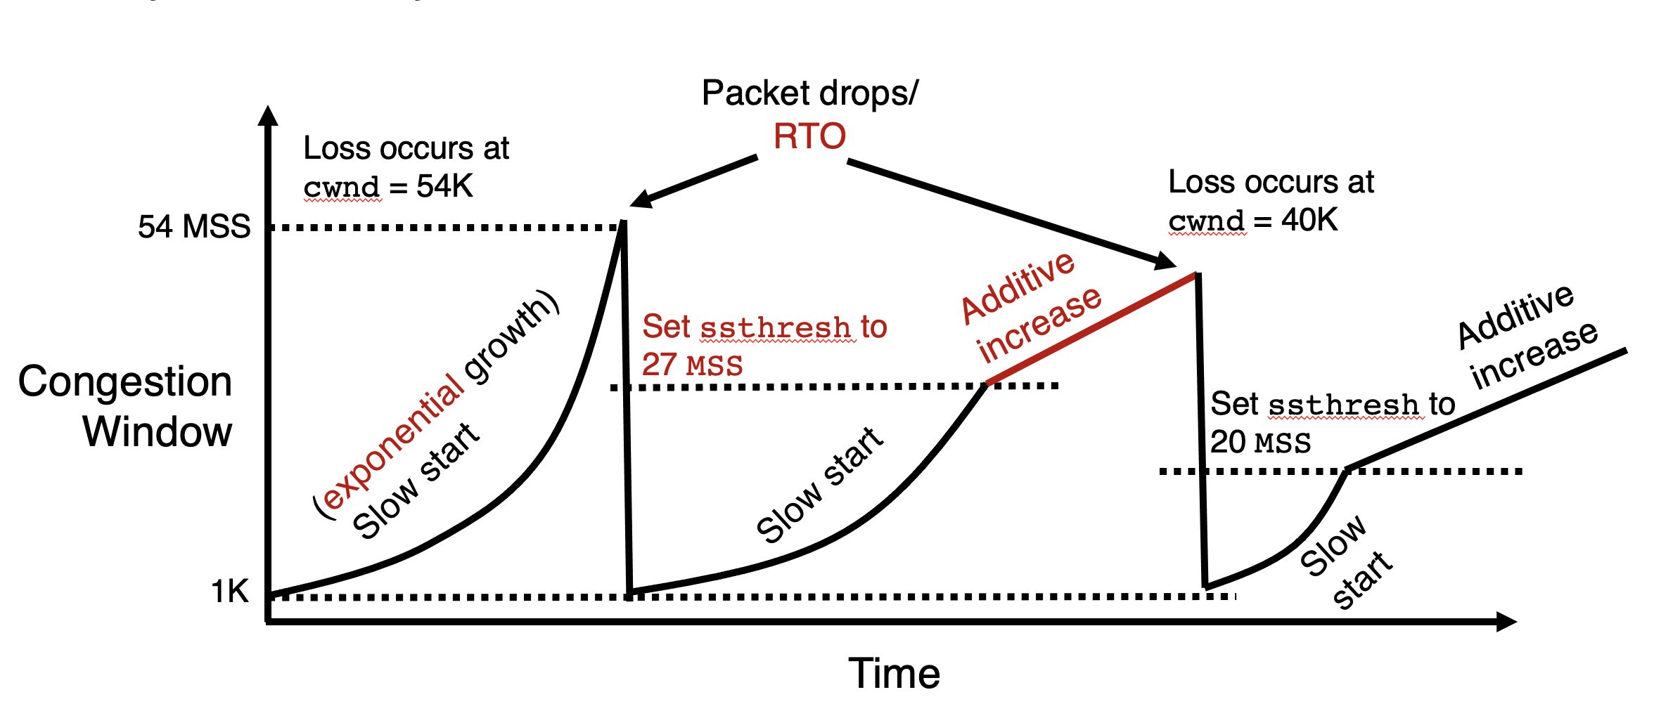
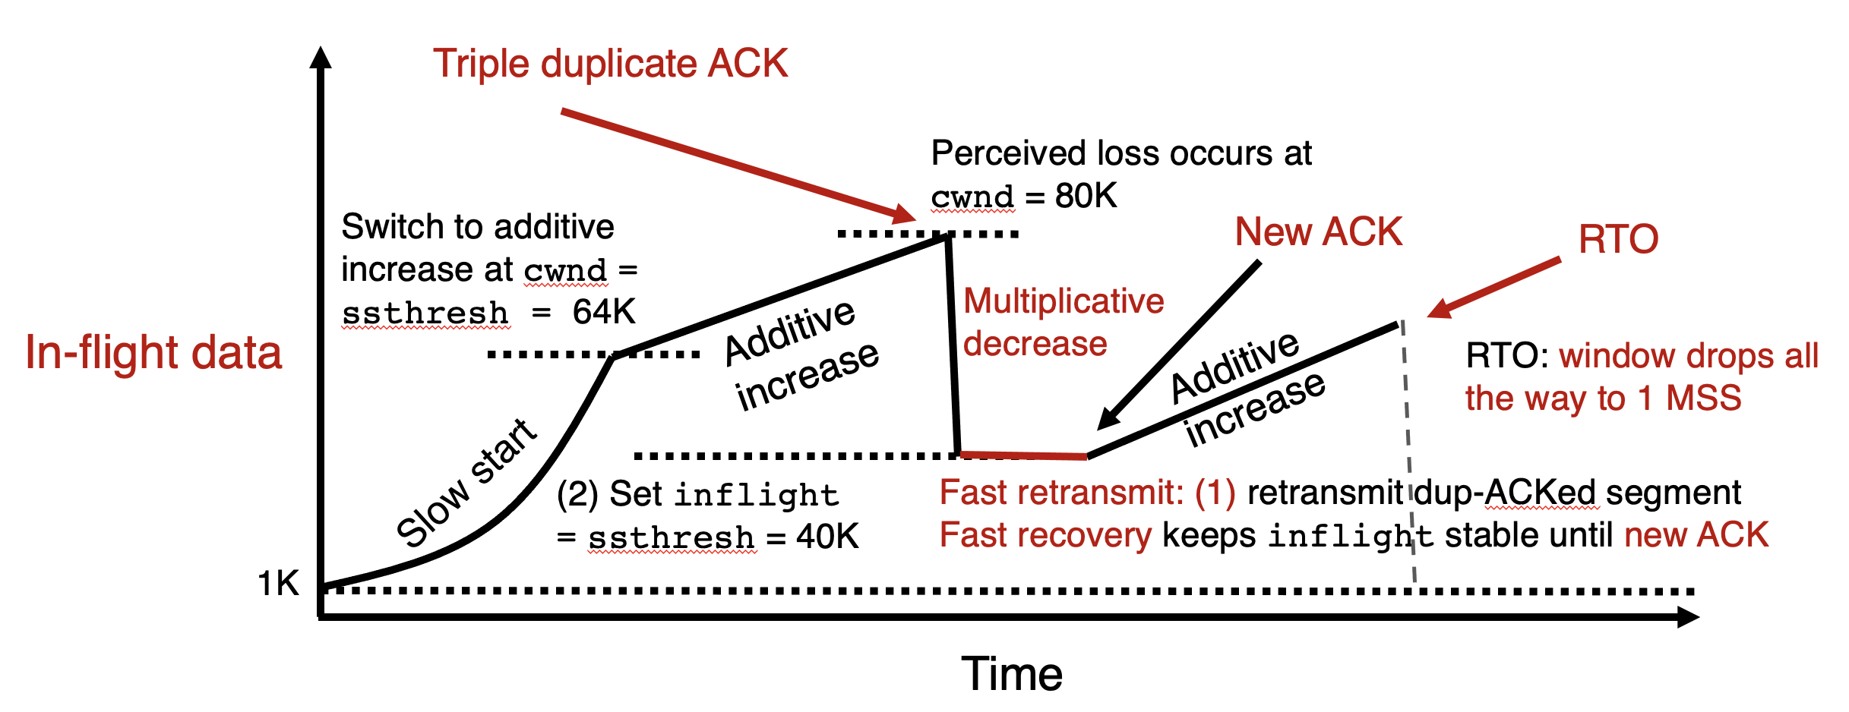


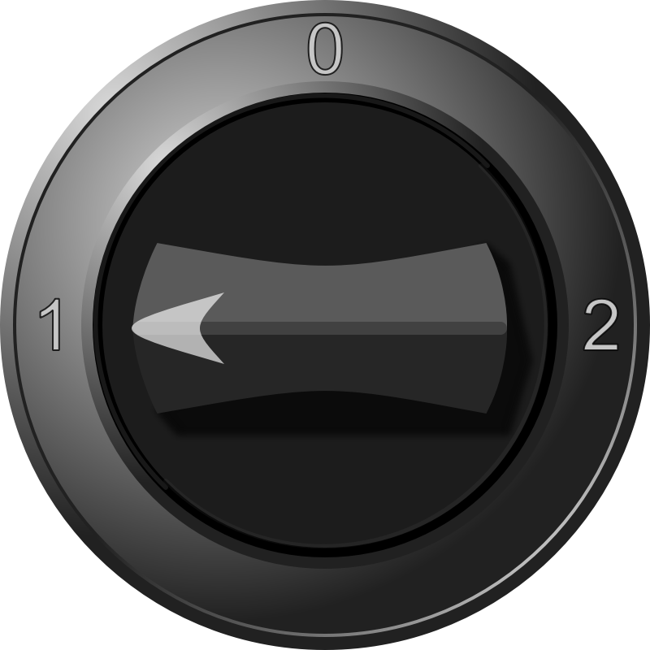
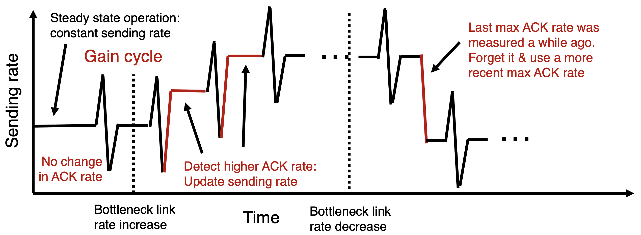
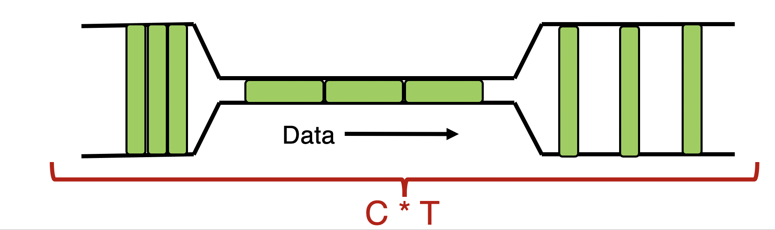
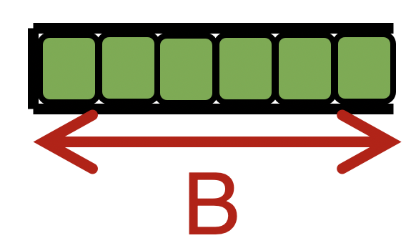

TCP New Reno
= slow start
+ congestion avoidance (AI)
+ fast retransmit & recovery (MD)
Congestion Control
Sense and React
H
C
TCP BBR: Gain cycling
Signals
Knobs
Bandwidth-Delay Product
cwnd < BDP: sender under-uses the link
BDP = cwnd: 100% link use, zero queues (ideal)
BDP < cwnd < BDP + B: persistent queue @ router
BDP + B < cwnd: packet drops

Slide 3
Detecting and Reacting to Packet Loss

Slide 4
Detecting packet loss
Congestion Window
Grow too fast
Drop too fast
1 MSS
Time
So far, all the algorithms we’ve studied have a coarse loss detection mechanism: RTO timer expiration
  Let the RTO expire, drop cwnd all the way to 1 MSS
Analogy: you’re driving a car
  You accelerate until the next car in front is super close to you (RTO) and then hit the brakes hard (cwnd := 1)
  Q: Can you see obstacles from afar and slow down proportionately?
That is, can the sender see packet loss coming in advance?
  And reduce cwnd more gently?

Slide 5
Can we detect loss earlier than RTO?
Key idea: use the information in the ACKs. How?
Suppose successive (cumulative) ACKs contain the same ACK#
  Also called duplicate ACKs
  Occur when network is reordering packets, or one (but not most) packets in the window were lost
Reduce cwnd when you see many duplicate ACKs
  Consider many dup ACKs a strong indication that packet was lost
  Default threshold: 3 dup ACKs, i.e., triple duplicate ACK
  Make cwnd reduction gentler than setting cwnd = 1; recover faster

Slide 6
Fast Retransmit & Fast Recovery

Slide 7
Distinction: In-flight versus window
So far, window and in-flight referred to the same data
Fast retransmit/recovery differentiate the two notions
cwnd = 6
inflight = 3
Sender’s view:
0
1
2
3
4
5
6
7
0
1
0
1
2
3
4
5
6
7
0
1
Triple duplicate ACKs
(assume subsequent 3 pieces of data were successfully received)
Last cumulative
ACK’ed seq #
Last transmitted
seq #
cwnd is the interval between the last cumulatively ACK’ed seq# and the last transmitted seq#
inflight is the data currently believed to be in flight.

Slide 8
TCP fast retransmit (RFC 2581)
The fact that ACKs are coming means that data is getting delivered to the receiver, albeit with some loss.
Note: Before the dup ACKs arrive, we assume inflight = cwnd
TCP sender does two actions with fast retransmit

Slide 9
TCP fast retransmit (RFC 2581)
(1) Reduce the cwnd and in-flight gently
  Don’t drop cwnd all the way down to 1 MSS
Reduce the amount of in-flight data multiplicatively
  Set inflight → inflight / 2
  That is, set cwnd = (inflight / 2) + 3MSS
  This step is called multiplicative decrease
  Algorithm also sets ssthresh to inflight / 2

Slide 10
TCP fast retransmit (RFC 2581)
Example: Suppose cwnd and inflight (before triple dup ACK) were both 8 MSS.
After triple dup ACK, reduce inflight to 4 MSS
Assume 3 of those 8 MSS no longer in flight; set cwnd = 7 MSS
inflight = 4
cwnd = 7
cwnd = inflight = 8
0
1
2
3
4
5
6
7
0
1
2
3
4
5
6
7
0
1
5
Last cumulative
ACK’ed seq #
Assumed not in flight (dup ACK)

Slide 11
TCP fast retransmit (RFC 2581)
(2) The seq# from dup ACKs is immediately retransmitted
That is, don’t wait for an RTO if there is sufficiently strong evidence that a packet was lost

Slide 12
TCP fast recovery (RFC 2581)
Sender keeps the reduced inflight until a new ACK arrives
  New ACK: an ACK for the seq# that was just retransmitted
  May also include the (three or more) pieces of data that were subsequently delivered to generate the duplicate ACKs
Conserve packets in flight: transmit some data over lossy periods (rather than no data, which would happen if cwnd := 1)

Slide 13
TCP fast recovery (RFC 2581)
Keep incrementing cwnd by 1 MSS for each dup ACK
cwnd = 6
inflight = 3
0
1
2
3
4
5
6
7
0
1
2
3
4
5
6
7
0
1
5
Last cumulative
ACK’ed seq #
Assumed not in flight (dup ACK)

Slide 14
TCP fast recovery (RFC 2581)
Keep incrementing cwnd by 1 MSS for each dup ACK
cwnd = 7
inflight = 3
0
1
2
3
4
5
6
7
0
1
2
3
4
5
6
7
0
1
Last cumulative
ACK’ed seq #
Assumed not in flight (dup ACK)

Slide 15
TCP fast recovery (RFC 2581)
Keep incrementing cwnd by 1 MSS for each dup ACK
cwnd = 8
inflight = 3
0
1
2
3
4
5
6
7
0
1
2
3
4
5
6
7
0
1
Last cumulative
ACK’ed seq #
Assumed not in flight (dup ACK)

Slide 16
TCP fast recovery (RFC 2581)
Eventually a new ACK arrives, acknowledging the retransmitted data and all data in between
Deflate cwnd to half of cwnd before fast retransmit.
  cwnd and inflight are aligned and equal once again
Perform additive increase from this point!
cwnd = 3
inflight = 3
0
1
2
3
4
5
6
7
0
1
2
3
4
5
6
7
0
1
Last cumulative
ACK’ed seq #
New ACK acknowledged this data

Slide 17
Additive Increase/Multiplicative Decrease
Say MSS = 1 KByte
Default ssthresh = 64KB = 64 MSS
Triple duplicate ACK
Fast retransmit: (1) retransmit dup-ACKed segment
Perceived loss occurs at cwnd = 80K
Switch to additive increase at cwnd = ssthresh = 64K
New ACK
RTO
(2) Multiplicative decrease
In-flight data
Additive increase
Additive increase
RTO: window drops all the way to 1 MSS
Slow start
(2) Set inflight = ssthresh = 40K
Fast recovery keeps inflight stable until new ACK
1K
Time

Slide 18
TCP New Reno performs additive increase and multiplicative decrease of congestion window.
In short, we often refer to this as AIMD.
Multiplicative decrease is a part of all TCP algorithms, including BBR.
[It is necessary for fairness across TCP flows.]

Slide 19
Summary: TCP loss detection & reaction
Don’t wait for an RTO and then set the cwnd to 1 MSS
Instead, react proportionately by sensing pkt loss in advance
Fast Retransmit
Triple dup ACK: sufficiently strong signal that network has dropped data, before RTO
Immediately retransmit data
Multiplicatively decrease in-flight data to half of its value
Fast Recovery
Maintain this reduced amount of in-flight data as long as dup ACKs arrive
  Data is successfully getting delivered
When new ACK arrives, do additive increase from there on

Slide 20
Connection Management
How does a TCP connection start?

Slide 21




Starting a TCP connection
TCP requires sender/receiver to set up some context
  Sequence numbers, window size, buffers, OS table entries
Let’s talk. Here’s my request.
RTO
Provision enough socket buffers.
Sender
e.g., browser
Connection finished. Server forgot.
Attack by resource exhaustion at server
(SYN flood)
Receiver
e.g., web server
OK. Here’s my response.
Entries in operating system tables (connection lookup), choose sequence #, etc.
Server thinks new connection, may accept data!

Slide 22
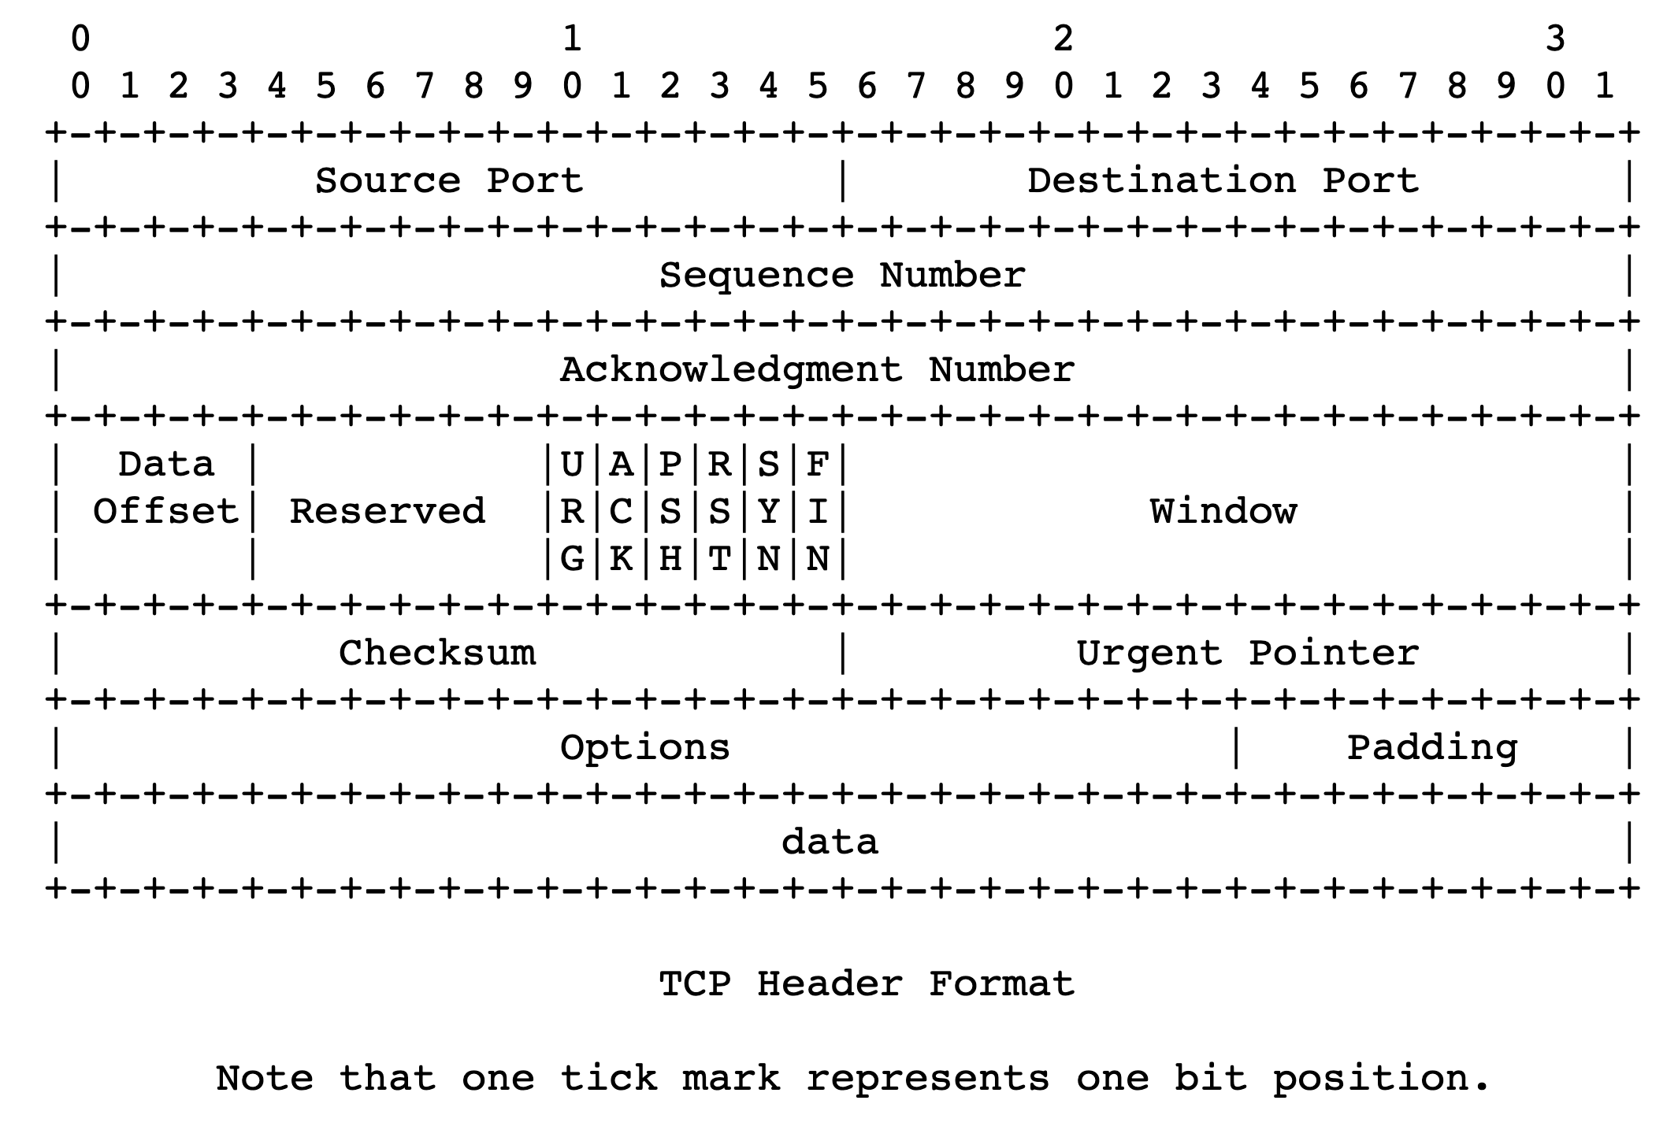
TCP 3-way handshake
Server state
ss = socket(AF_INET,SOCK_STREAM)
ss.bind((‘’,server_port))
ss.listen(1)
csockid, addr = ss.accept()
Client state
cs = socket(AF_INET, SOCK_STREAM)
LISTEN
cs.connect((host,server_port))
LISTEN
choose init seq num, x
send TCP SYN msg
No app data
SYNbit=1, Seq=x
SYNSENT
choose init seq num, y
send TCP SYNACK
msg, acking SYN
SYN RCVD
SYNbit=1, Seq=y
ACKbit=1; ACKnum=x+1
received SYNACK(x)
indicates server is live;
send ACK for SYNACK;
this segment may contain
client-to-server data
received ACK(y)
indicates client is live
ESTAB
ACKbit=1, ACKnum=y+1
Provision resources
ESTAB
Notes:
TCP’s three way handshake, that operates as follows
Let’s say the client and server both create a TCP socket as we learned about in Chapter 2 and enter the LISTEN state
The client then connects to the server sending a SYN message with a sequence number x (SYN Message is an TCP Segment with SYN but set in the header – you might want to go back and review the TCP segment format!)
The server is waiting for a connection, and receives the SYN message enters the SYN received state (NOT the established state and sends a SYN ACK message back.
Finally the client sends an ACK message to the server, and when the server receiver this enters the ESTABLished state. This is when the application process would see the return from the wait on the socket accept() call

Slide 23
Implications of 3-way handshake
Any application data can only be sent an RTT after
Fresh connection: at least 2 RTTs to get a response
  Often fruitful to use “persistent” connections (HTTP header)

Slide 24


The Transport Layer
Communication abstraction between processes
Intelligent endpoints implementing guarantees for applications

Slide 25
Network
Application
HTTPS
FTP
HTTP
SMTP
DNS
Transport
TCP
UDP
Net layer
Network
IP
Host-to-Net
X.25
…
802.11
ATM

Slide 26




The network layer
Endpoint
Main function: Move data from sending to receiving endpoint
on sending endpoint: encapsulate transport segments into datagrams
on receiving endpoint: deliver datagrams to transport layer
The network layer also runs in every router
  Very challenging to evolve the network layer
Routers examine headers on all passing through them
Process
Network Layer
Process
Endpoint

Slide 27
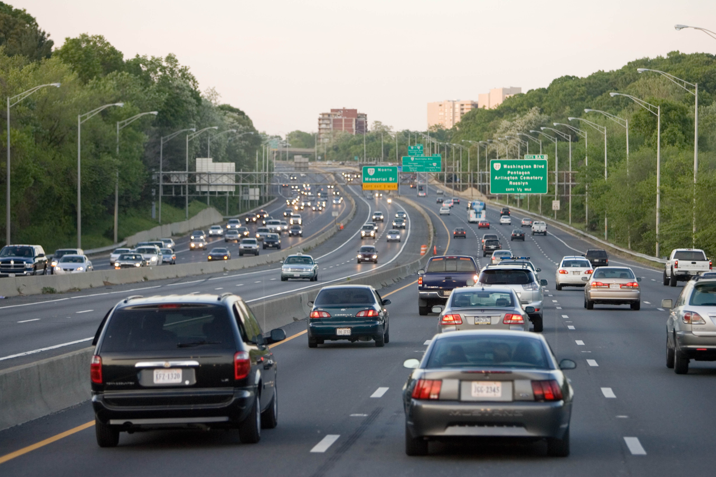
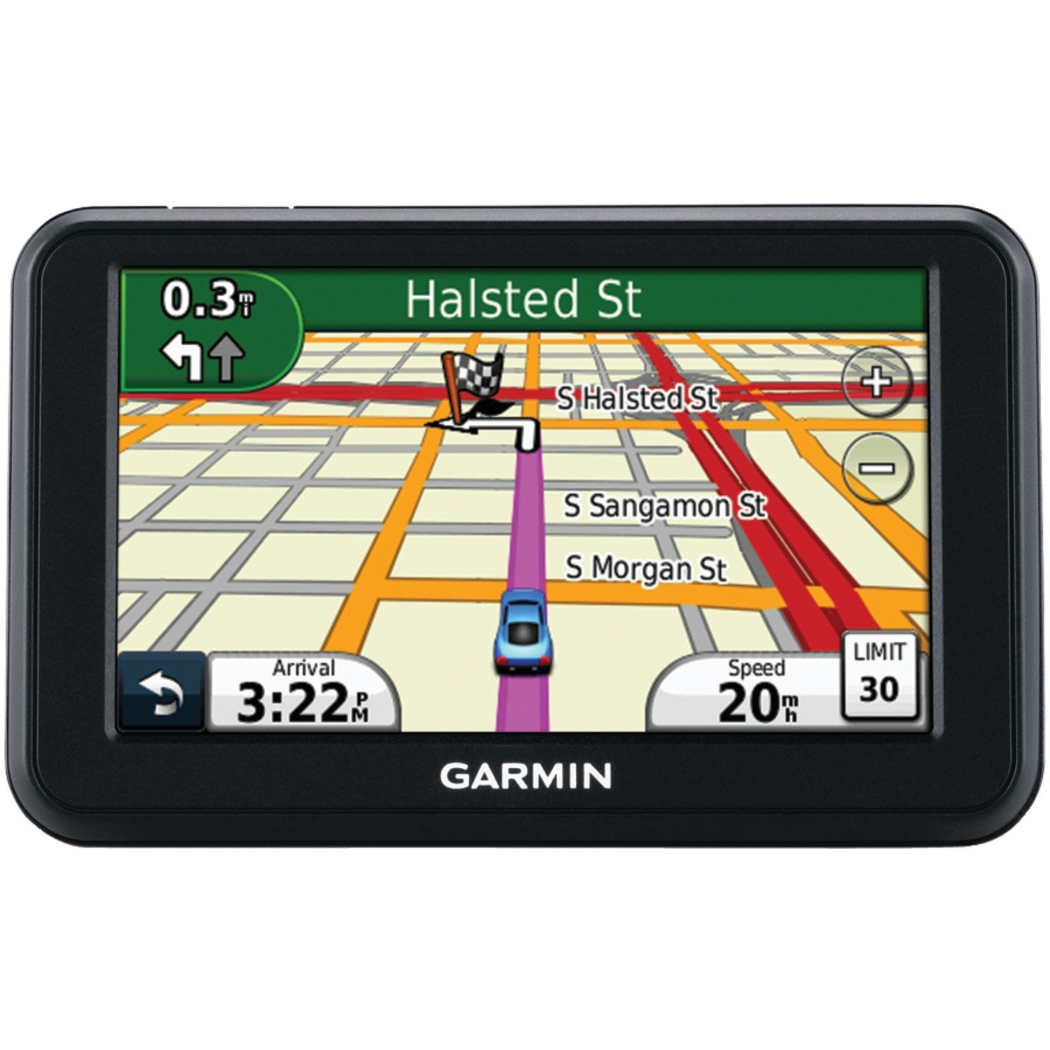
Two key network-layer functions
Forwarding: move packets from router’s input to appropriate router output
Routing: determine route taken by packets from source to destination
  routing algorithms
The network layer solves the routing problem.
Analogy: taking a road trip
Forwarding: process of getting through single interchange
Routing: process of planning trip from source to destination
network
layer
runs
everywhere

Slide 28
Data plane and Control Plane
Data plane = Forwarding
local, per-router function
determines how datagram arriving on router input port is forwarded to router output port
Control plane = Routing
network-wide logic
determines how datagram is routed along end-to-end path from source to destination endpoint
two control-plane approaches:
  Distributed routing algorithm running on each router
  Centralized routing algorithm running on a (logically) centralized server
values in arriving
packet header
0111
1
3
2

