Slide 1

CS 352
Video Streaming
Lecture 8
http://www.cs.rutgers.edu/~sn624/352-F22
Srinivas Narayana

Slide 2
Review of concepts
outgoing
message queue
user mailbox
E-mail: user agents, mail servers, SMTP
SMTP: Push-based protocol
Mail access protocols: POP, IMAP. Pull based.
How web-based email works
Can stuff multiple objects into one email, multimedia, with MIME
ASCII/plain-text based
Use headers to evolve protocols and add functionality
HTTP
user
agent
web
server
mail
server
IMAP
user
agent
SMTP
mail
server
user
agent
SMTP
SMTP
mail
server
user
agent
IMAP
user
agent
user
agent

Slide 3




Today’s lecture: Internet Multimedia
Many applications on the Internet use audio or video
IP video traffic will be 82 percent of all IP traffic […] by 2022, up from 75 percent in 2017
CCTV traffic over the Internet will increase sevenfold between 2017 to 2022
Internet video to TV will increase threefold between 2017 to 2022.
Consumer Video-on-Demand (VoD) traffic will nearly double by 2022
Source: Cisco visual networking index 2017--22
3

Slide 4
What’s different about these applications?
Traditional applications (HTTP(S), SMTP)
  Delay tolerant but not loss tolerant
  Data used after transfer complete
Multimedia applications are often real time
  Data delivery time during transfer matters for user experience
Video/audio streaming
  Delay-sensitive
Real-time audio and video
  Delays > 400 ms for audio is a bad user experience
  Somewhat loss tolerant
4

Slide 5
Multimedia
Data Representations

Slide 6
Digital representation of audio and video

Slide 7
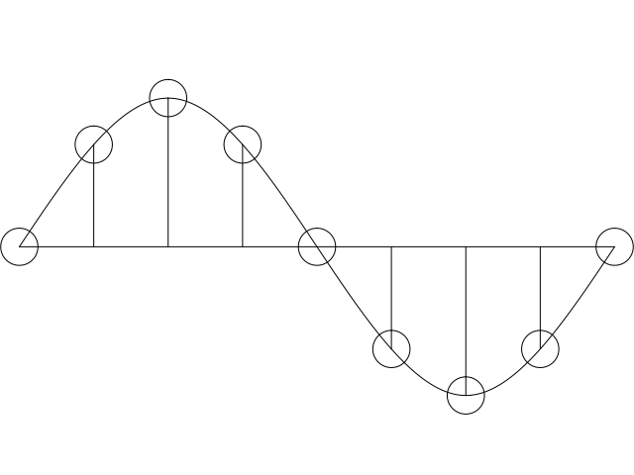
Digital representation of audio
Must convert analog signal to digital representation
Sample
  How many times (twice the max frequency in the signal)
Quantize
  How many levels or bits to represent each sample
  More levels ➔ more accurate representation of signal
  More levels ➔ more bits to store & need more bandwidth to transmit
Compress
  Compact representation of quantized values
7

Slide 8
Audio representation
analog audio signal sampled at constant rate
  telephone: 8,000 samples/sec
  CD music: 44,100 samples/sec
each sample quantized, i.e., rounded
  e.g., 2⁸=256 possible quantized values
  each quantized value represented by bits, e.g., 8 bits for 256 values
quantization error
quantized value of
analog value
analog
signal
audio signal amplitude
time
sampling rate
(N sample/sec)

Slide 9
Audio representation
example: 8,000 samples/sec, 256 quantized values
Bandwidth needed: 64,000 bps
receiver converts bits back to analog signal:
  some quality reduction
Example rates
CD: 1.411 Mbps
MP3: 96, 128, 160 Kbps
Internet telephony: 5.3 Kbps and up
quantization error
quantized value of
analog value
analog
signal
audio signal amplitude
time
sampling rate
(N sample/sec)

Slide 10

Video representation
Video: sequence of images displayed at constant rate
  e.g., 30 images/sec
  Appear continuous due to the stroboscopic effect
frame i
frame i+1

Slide 11
Video representation
spatial coding example: instead of sending N values of same color (all purple), send only two values: color value (purple) and number of repeated values (N)
Digital image: array of pixels
  each pixel represented by bits
  Encode luminance and color
  Number of pixels: resolution
Coding: use redundancy within and between images to decrease # bits used to encode image
  spatial (within image)
  temporal (from one image to next)
Coding/decoding algorithm
often called a codec
……………………...…
……………………...…
frame i
temporal coding example: instead of sending complete frame at i+1, send only differences from frame i (motion vectors)
frame i+1

Slide 12
Video codecs: terminology
Video bit rate: effective number of bits per second of the video after encoding
It depends on many factors
  Resolution of each image: more pixels = more bits
  Detail per pixel: better luminance & color detail = more bits
  Amount of movement in the video. More movement = more bits
  Quality of overall compression in the codec
Video bit rate is typically correlated with quality of perception.
  Higher bit rate == better to perceive

Slide 13
Bit-rates: terminology
Bit-rate of a video changes over the duration of the video
CBR: (constant bit rate): fixed bit-rate video
VBR: (variable bit rate): different parts of the video have different bit rates, e.g., changes in color, motion, etc.
  For VBR, we talk about average bit-rate over video’s duration
Examples of average video bit-rates
  MPEG 1 (CD-ROM) 1.5 Mbps. MPEG2 (DVD) 3-6 Mbps
  MPEG4 (often used in Internet, < 1 Mbps)
  In general, one Internet video stream takes up a few Mbit/s (unless HD)
https://blog.video.ibm.com/streaming-video-tips/what-is-video-encoding-codecs-compression-techniques/

Slide 14
Networking multimedia: 3 types
On-demand streamed video/audio
  Can begin playout before downloading the entire file
  Ful video/audio stored at the server: able to transmit faster than audio/video will be rendered (with storing/buffering at client)
  e.g., Spotify, YouTube, Netflix
Conversational voice or video over IP
  interactive human-to-human communication limits delay tolerance
  e.g., Zoom, Google Stadia
Live streamed audio, video
  e.g, sporting event on sky sports
  Can delay a little, but must be close to the “live edge” of content

Slide 15
On-demand Video Streaming

Slide 16
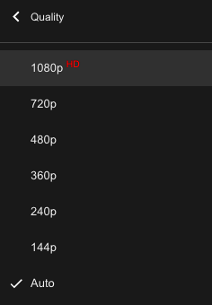
Streaming (stored) video
Media is prerecorded at different qualities
  Available in storage at the server
Client downloads an initial portion and starts viewing
  The rest is downloaded as time progresses
  No need for user to wait for entire content to be downloaded!
Can change the quality of the content and where it’s fetched mid-stream
  More on this soon

Slide 17


Streaming stored video
Constant bit rate video
Cumulative data (e.g. bytes)
Client
e.g., your phone
2. video
sent
video
recorded (e.g., 30 frames/sec)
3. video received,
played out at client
(30 frames/sec)
network delay
(fixed in this example)
time
streaming: at this time, client
playing out early part of video,
while server still sending later
part of video
Server
e.g. Netflix

Slide 18

Streaming stored video: challenges
Continuous playout constraint: once video playout begins at client, time gap between frames must match the original time gap in the video (why?)
But network delays are variable!
Clients have a client-side buffer of downloaded video to absorb variation in network conditions
Buffer also helps with user interactions: pause, fast-forward, rewind, jump through video

Slide 19
Scenario 1: Constant bit-rate video
constant bit
rate video
transmission
client video
reception
constant bit
rate video
playout at client
Cumulative data
variable
network
delay
buffered
video
client playout
delay
time
Client-side buffering with playout delay:
compensate for network-added delays and variations in the delay

Slide 20
Scenario 2: Small playout delay
constant bit
rate video
transmission
client video
reception
constant bit
rate video
playout at client
Cumulative data
variable
network
delay
buffered
video
client playout
delay
time
Playout delay that’s too small can cause stalls
There’s nothing in the buffer to show to the user

Slide 21

Client-side buffering, playout
buffer fill level, B(t)
variable fill
rate, x(t)
playout rate,
e.g., CBR r
video server
Client’s
buffer, size B_{max}
client
Most video is broken up in time into multiple segments
Client downloads video segment by segment
For example: a segment might be 4 seconds worth of video.

Slide 22
Client-side buffering, playout
buffer fill level, B(t)
variable fill
rate, x(t)
playout rate,
e.g., CBR r
video server
Client’s
buffer, size B_{max}
client
1. Initial fill of buffer until playout begins at t_{p}
2. playout begins at t_{p}
3. buffer fill level varies over time as fill rate x(t) varies (assume playout rate r is constant for now)

Slide 23
Client-side buffering, playout
buffer fill level, B(t)
variable fill
rate, x(t)
playout rate,
e.g., CBR r
video server
Client’s
buffer, size B_{max}
playout buffering: average fill rate (x), playout rate (r):
x < r: buffer eventually empties for a sufficiently long video. Stall and rebuffering
x > r: buffer will not empty, provided the initial playout delay is large enough to absorb variability in x(t)
  initial playout delay tradeoff: buffer starvation less likely with larger delay, but also incur a larger delay until the user begins watching

Slide 24
Client-side buffering, playout
buffer fill level, B(t)
variable fill
rate, x(t)
playout rate,
e.g., CBR r
video server
Client’s
buffer, size B_{max}
playout buffering: average fill rate (x), playout rate (r):
is x < r or x > r for a given network connection?
It is hard to predict this in general!
  Best effort network suffers long queues, paths with low bandwidth, …
How to set playout rate r?
  Too low a bit-rate r: video has poorer quality than needed
  Too high a bit-rate r: buffer might empty out. Stall/rebuffering!

Slide 25
Adaptive bit–rate video
Motivation: Want to provide high quality video experience, without stalls
Observations:
  Videos come in different qualities (average bit rates)
  Versions of the video for different quality levels readily available
  Different segments of video can be downloaded separately
Adapt bit rate per segment through collaboration between the video client (e.g., your browser) and the server (e.g., @ Netflix)
Adaptive bit-rate (ABR) video: change the bit-rate (quality) of next video segment based on network and client conditions
A typical strategy: Buffer-based rate adaptation

Slide 26
Buffer-based bit-rate adaptation
Key idea: If there is a large stored buffer of video, optimize aggressively for video quality, i.e., high bit rates
Else (i.e., buffer has low occupancy), avoid stalls by being conservative and ask for a lower quality (bit-rate)
  Hope: lower bandwidth requirement of a lower quality stream is satisfiable more easily

Slide 27
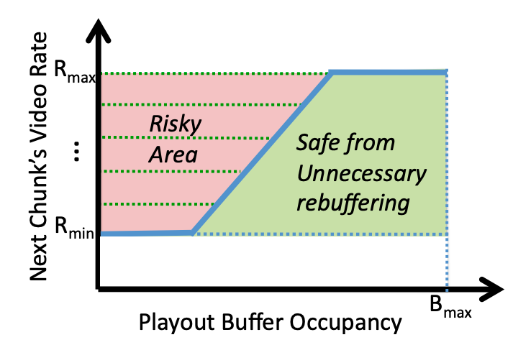
Buffer-based bit-rate adaptation
A highly effective method to provide high video quality despite variable and intermittently poor
network conditions.
Used by Netflix.
http://yuba.stanford.edu/~nickm/papers/sigcomm2014-video.pdf
A Buffer-Based Approach to Rate Adaptation

